Slide 1


Slide 2
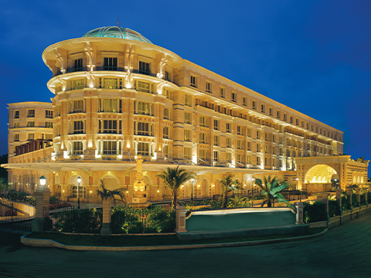
INTRODUCTION
ITC Hotels is India's leading luxury hospitality chain, part of ITC Limited. Known for premium properties like ITC Grand Chola and ITC Maurya, they blend traditional Indian hospitality with modern amenities. The chain emphasizes sustainable luxury, exceptional service, and fine dining, primarily serving business travelers and luxury tourists across India.

Slide 3

Problem Statement
ITC Hotels is a luxury hotel chain that operates multiple properties with diverse room categories and varying occupancy rates. The company wants to gain deeper insights into its overall financial performance, customer booking behaviour, occupancy trends, and room category performance to optimize revenue generation, minimize cancellations, and enhance customer satisfaction. The goal of this project is to create an interactive, multi-page Power BI dashboard to provide stakeholders with real-time insights for decision-making.

Slide 4
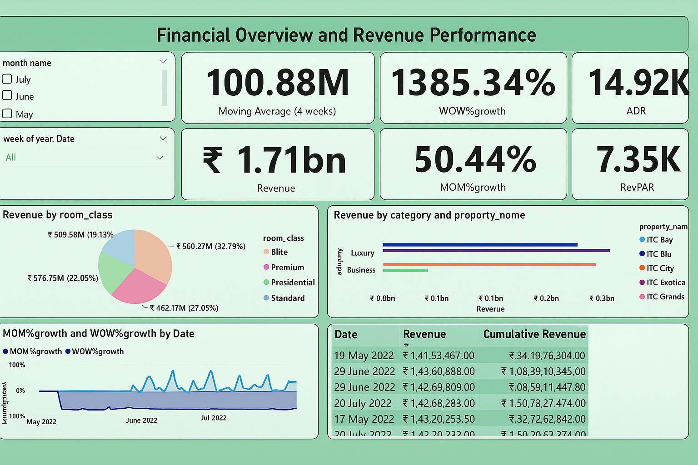

Slide 5
ITC Hotels Data Analytical Dashboard
Revenue Performance:
Strong Revenue Generation: Total revenue reached ₹1.71 billion during the period.
High Moving Average: 4-week moving average stood at ₹100.88M, showing sustained high revenue levels.
Significant Month-over-Month (MOM) Growth: Revenue rose by 50.44% MOM.
Exceptional Week-over-Week (WOW) Growth: Revenue spiked by 1385.34% WOW, indicating event-driven or seasonal demand surges.
Healthy ADR and RevPAR: ADR was ₹14.92K and RevPAR ₹7.35K, reflecting strong pricing strategy and occupancy.
Revenue Distribution:
By Room Class:
Premium: ₹560.27M (32.79%) — highest contributor.
Presidential: ₹509.58M (19.13%).
Standard: ₹462.17M (27.05%).
Blite: ₹576.75M (22.05%).
By Property: ITC Blu and ITC Bay lead in Luxury segment; ITC City leads in Business segment.
By Category: Luxury outperforms Business in total revenue generated.
Growth & Trend Analysis:
Stable Cumulative Revenue Growth: Continuous increase from May to July 2022, crossing ₹1.5B by mid-July.
WOW% Growth Volatility: Weekly revenue changes show sharp fluctuations, suggesting reliance on high-impact events.
MOM% Growth Stability: Month-over-month growth remains consistently positive.

Slide 6
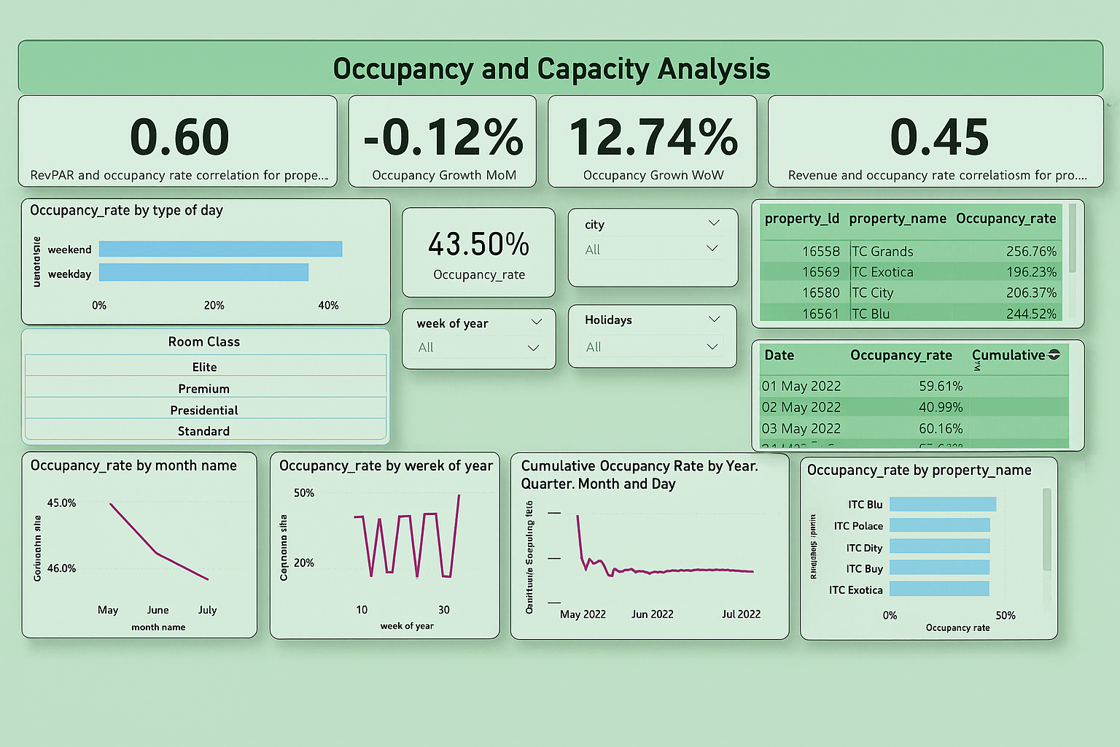

Slide 7
ITC Hotels Occupancy and Capacity Analysis
Occupancy Performance:
Overall Occupancy Rate: 43.50% across the period.
Correlation with Revenue:
RevPAR and occupancy rate correlation: 0.60 (moderate positive relationship).
Revenue and occupancy rate correlation: 0.45 (low to moderate positive relationship).
Occupancy Growth:
Month-over-Month (MOM): -0.12%, indicating slight decline.
Week-over-Week (WOW): 12.74%, showing short-term improvement.
Occupancy Patterns:
By Day Type: Weekend occupancy is slightly higher than weekday occupancy, suggesting leisure demand boosts.
By Month: Occupancy declined from ~46% in May to ~43% in July, showing a gradual downward trend over the three months.
By Week of Year: Weekly occupancy shows significant fluctuations, indicating variability in bookings.
Property-Level Insights:
Top Occupancy Rates (Property IDs):
TC Grands: 256.76%
TC Blu: 244.52%
TC City: 206.37%
TC Exotica: 196.23%
By Property Name: ITC Blu and ITC Palace lead in occupancy, followed closely by ITC City and ITC Buy.
Trend Observations:
Cumulative Occupancy: Steady but slightly declining trend from May through July 2022.
Volatility: Weekly and daily occupancy rates show frequent peaks and drops, suggesting a mix of business and event-driven stays.

Slide 8
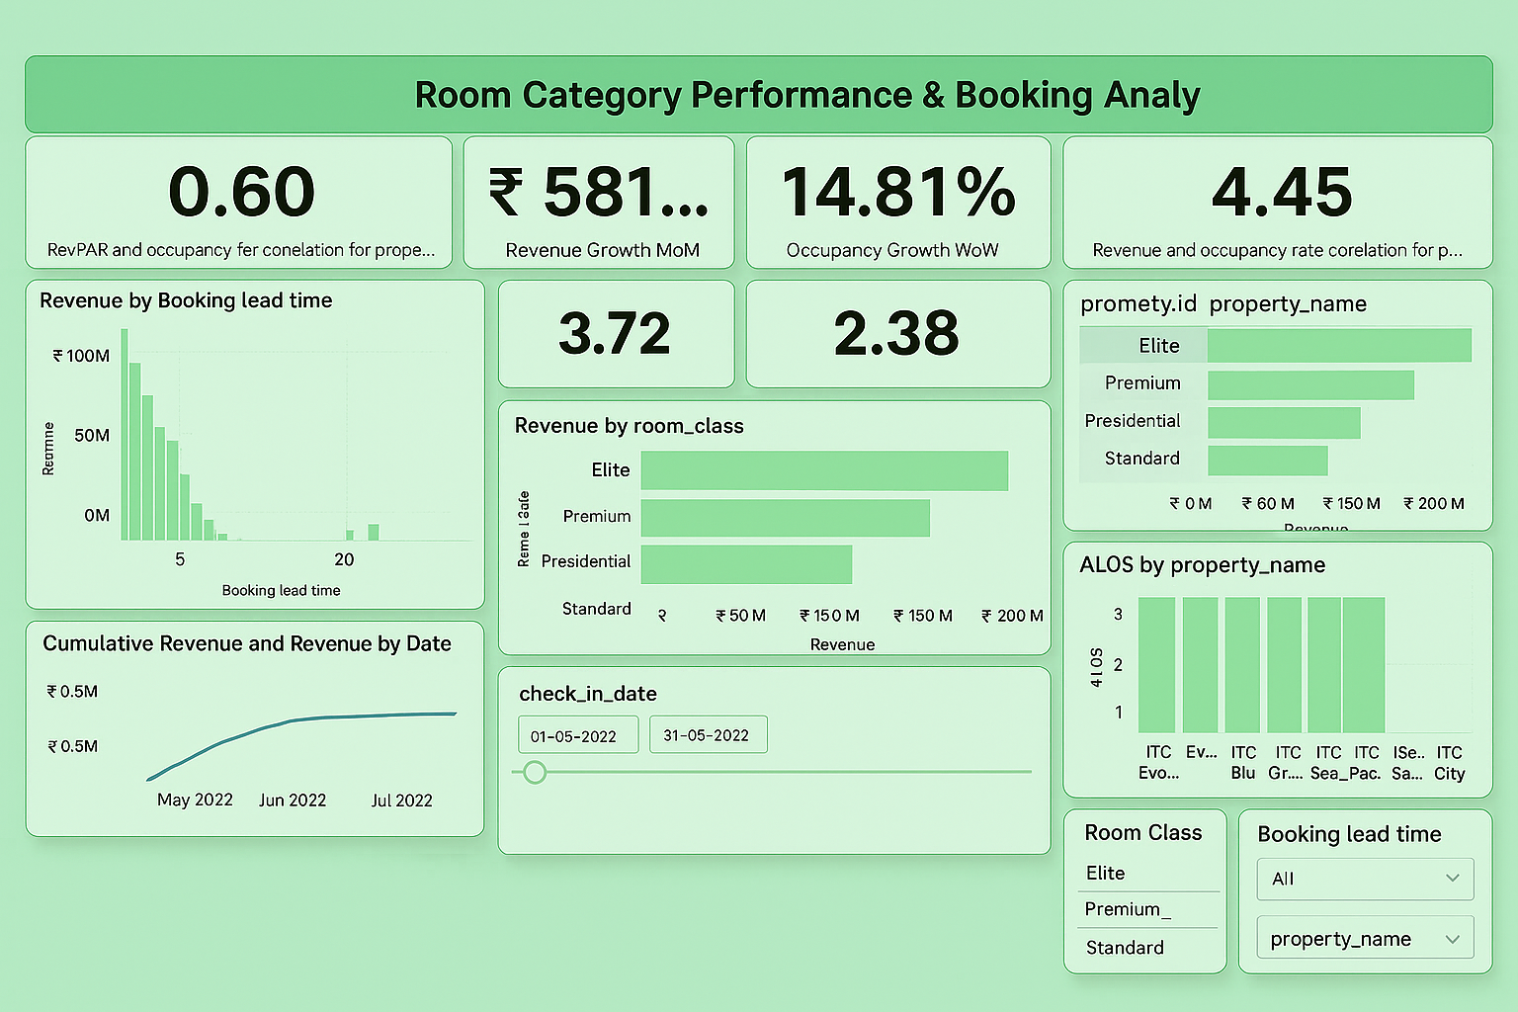

Slide 9
ITC Hotels Room Category Performance & Booking Analysis
Key Performance Metrics:
Revenue Growth: ₹581M month-over-month growth with 14.81% week-over-week occupancy increase
Correlations: RevPAR-occupancy (0.60), Revenue-occupancy (4.45) indicating effective rate management
Operational Ratios: 3.72 and 2.38 performance indicators
Revenue by Room Category:
Elite: ~₹200M (top performer)
Premium: ~₹150M
Presidential: ~₹100M
Standard: ~₹50M
Booking Insights:
Optimal Lead Time: 1-5 days advance booking generates peak revenue (₹100M+)
Property ALOS: Consistent 3+ day stays across ITC Evolution, Blu, Grand, Sea Palace, and City
Seasonal Trend: Steady cumulative revenue growth reaching ₹0.5M by July 2022
Strategic Highlights: Elite rooms drive 40% of total revenue, while advance booking preference (1-5 days) dominates guest behavior, suggesting successful luxury positioning and planned travel market capture.

Slide 10
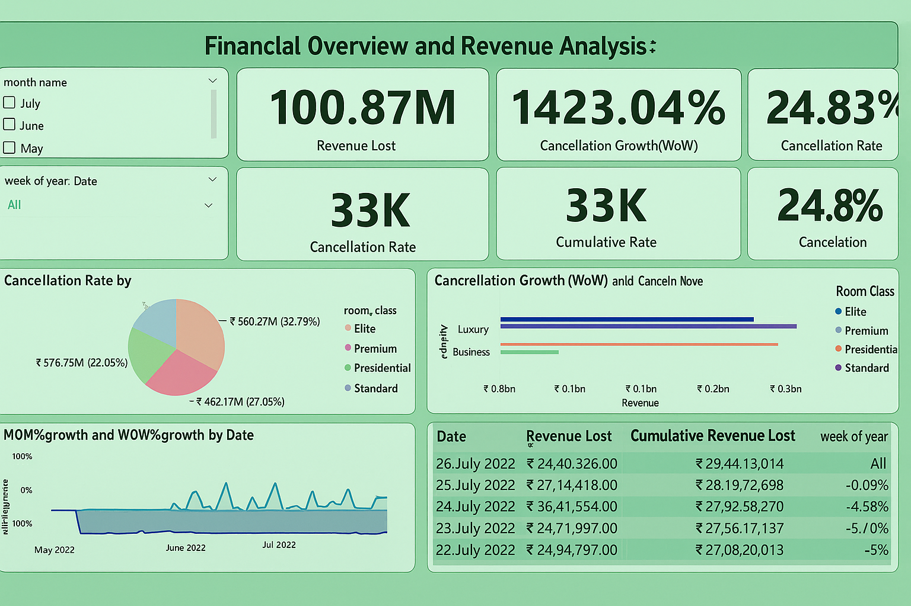

Slide 11
ITC Hotels Financial Overview and Revenue Analysis
Financial Impact Metrics:
Revenue Lost: ₹100.87M total revenue impact from cancellations
Cancellation Statistics: 33K total cancellations with 33K cumulative rate
Growth Indicators: 1423.04% week-over-week cancellation growth, 24.83% overall cancellation rate
Cancellation Analysis by Room Category:
Elite: ₹560.27M (32.79% of cancellation impact)
Premium: ₹462.17M (27.05% impact)
Presidential: ₹576.75M (22.05% impact)
Standard: Remaining portion of cancellation revenue
Operational Performance:
Cancellation Rate: 24.8% across all categories
Growth Volatility: Significant week-over-week fluctuations ranging from -100% to +50% in MOM/WOW growth patterns
Revenue Distribution: Luxury and Business segments show comparable revenue bands (₹0.1bn-₹0.3bn)
Daily Revenue Loss Tracking:
Peak Loss Days:
July 24: ₹36.41M (highest single-day impact)
July 25: ₹27.14M
July 26: ₹24.40M

Slide 12
Thank You!!! Presented By- Navneet Narayan

